Slide 1
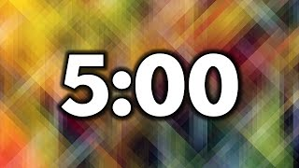


Daily Typing Do-Now
Open typing.com
Log into your account
Complete a 1 minute typing test
With the remaining 4 minutes
Work on a typing lesson
Play a typing game
Complete more typing tests

Slide 2
Modern AI & Neural Networks
Intro to Computer Science

Slide 3
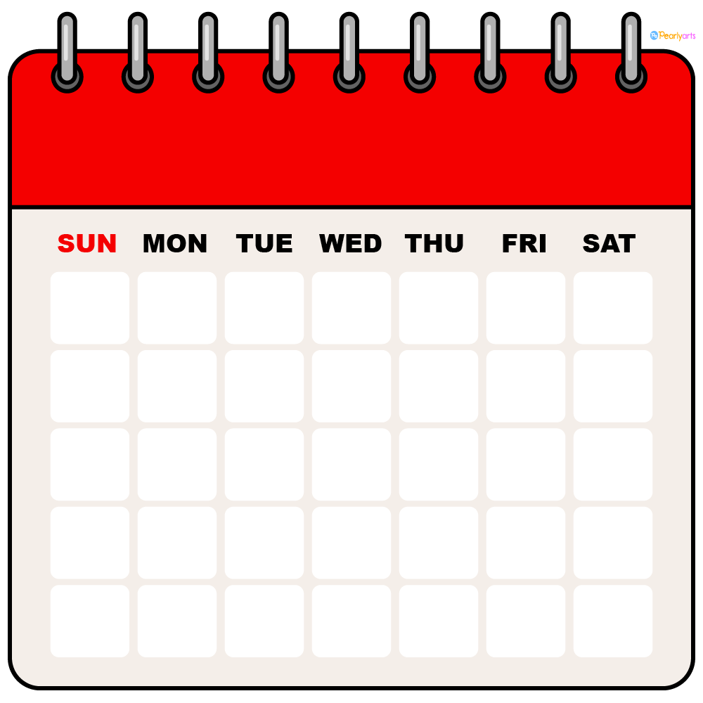
Schedule
Week 14
Monday - Neural Networks Structures
Tuesday - Language Modeling
Wednesday - LLMs
Thursday - Neural Network Coding
Friday - Modify Classifier Project

Slide 4
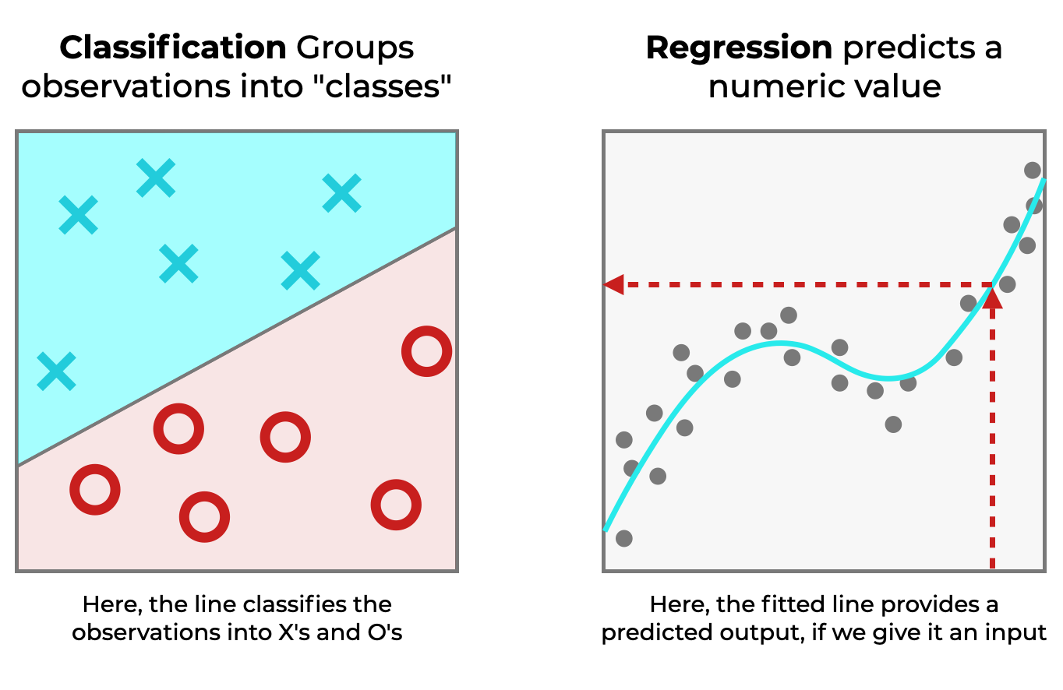
Tasks in Machine Learning

Slide 5
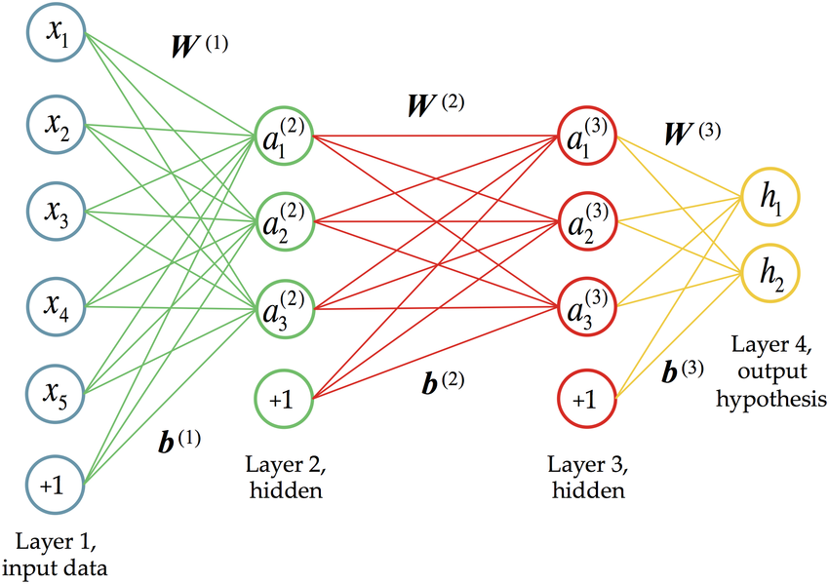
Neural Networks

Slide 6
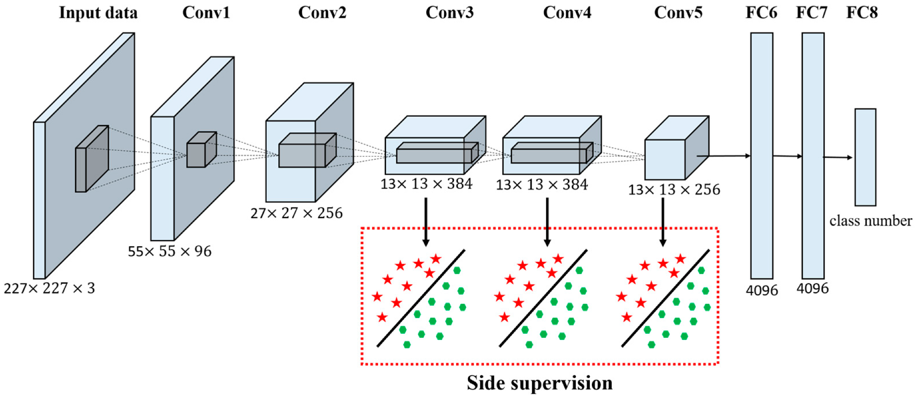
AlexNet (2012)
Could predict if an object was one of 1,000 distinct categories
Used an 8 layer neural network
Each image was given 224 x 224 resolution
57.1% Accuracy

Slide 7
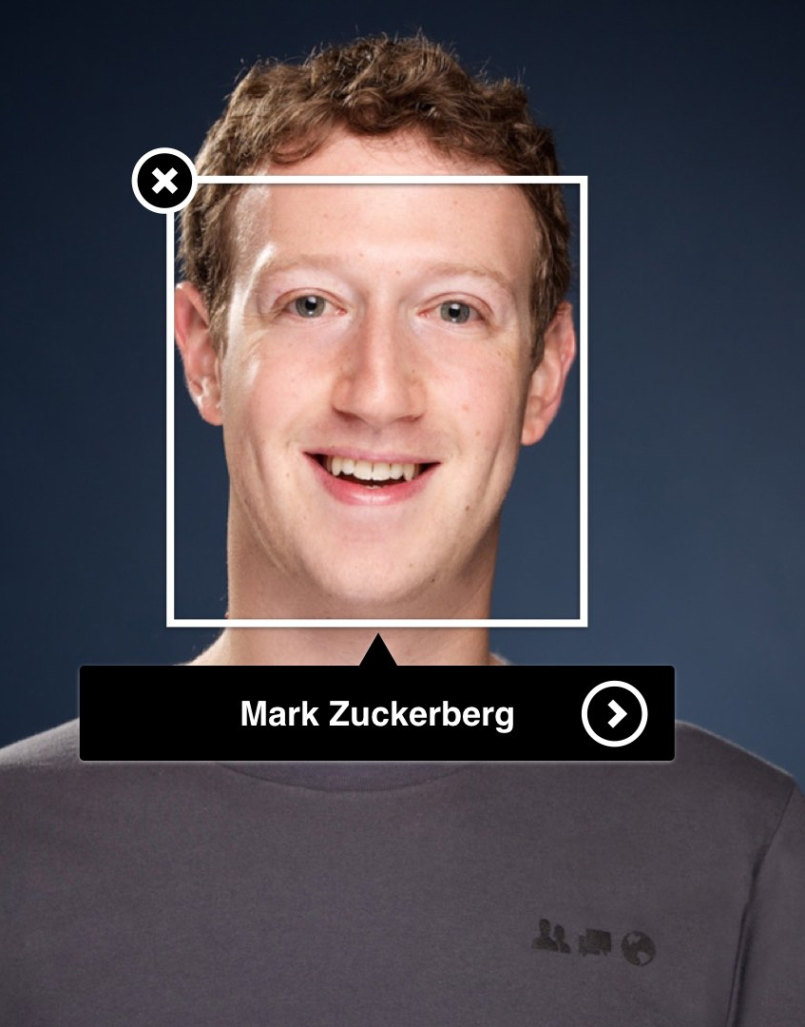
Facebook DeepFace (2014)
Could classify its 1 billion users by face
Achieved 97.35% accuracy on facial recognition
Utilized a 9 layer neural network
Scales faces down to a 152x152 image

Slide 8
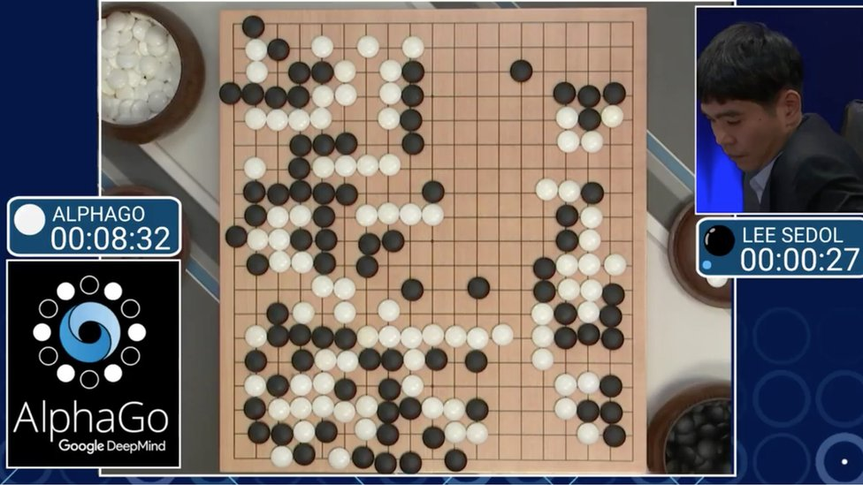
AlphaG0 (2016)
Go is a strategy game invented in China 2,500 years ago
It is a vastly more complex game then chess and is much more open ended
A team at google used a neural network to defeat the best Go players in 2016
AlphaGo used a 13 layer neural network

Slide 9
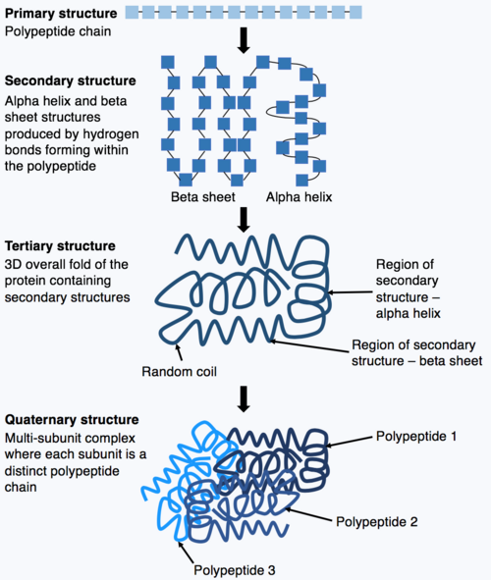
AlphaFold (2018)
A team at Google used neural networks to discover the 3D structures of various proteins
This is a very difficult task
Created a database of 365,000 unique proteins
Google used a 50 layer neural network to complete this task
This yielded massive scientific and medical benefits
Covid Vaccines were developed using these models

Slide 10
Tensorflow Playground

